Slide 1


Basic Laboratory Equipment

Slide 2
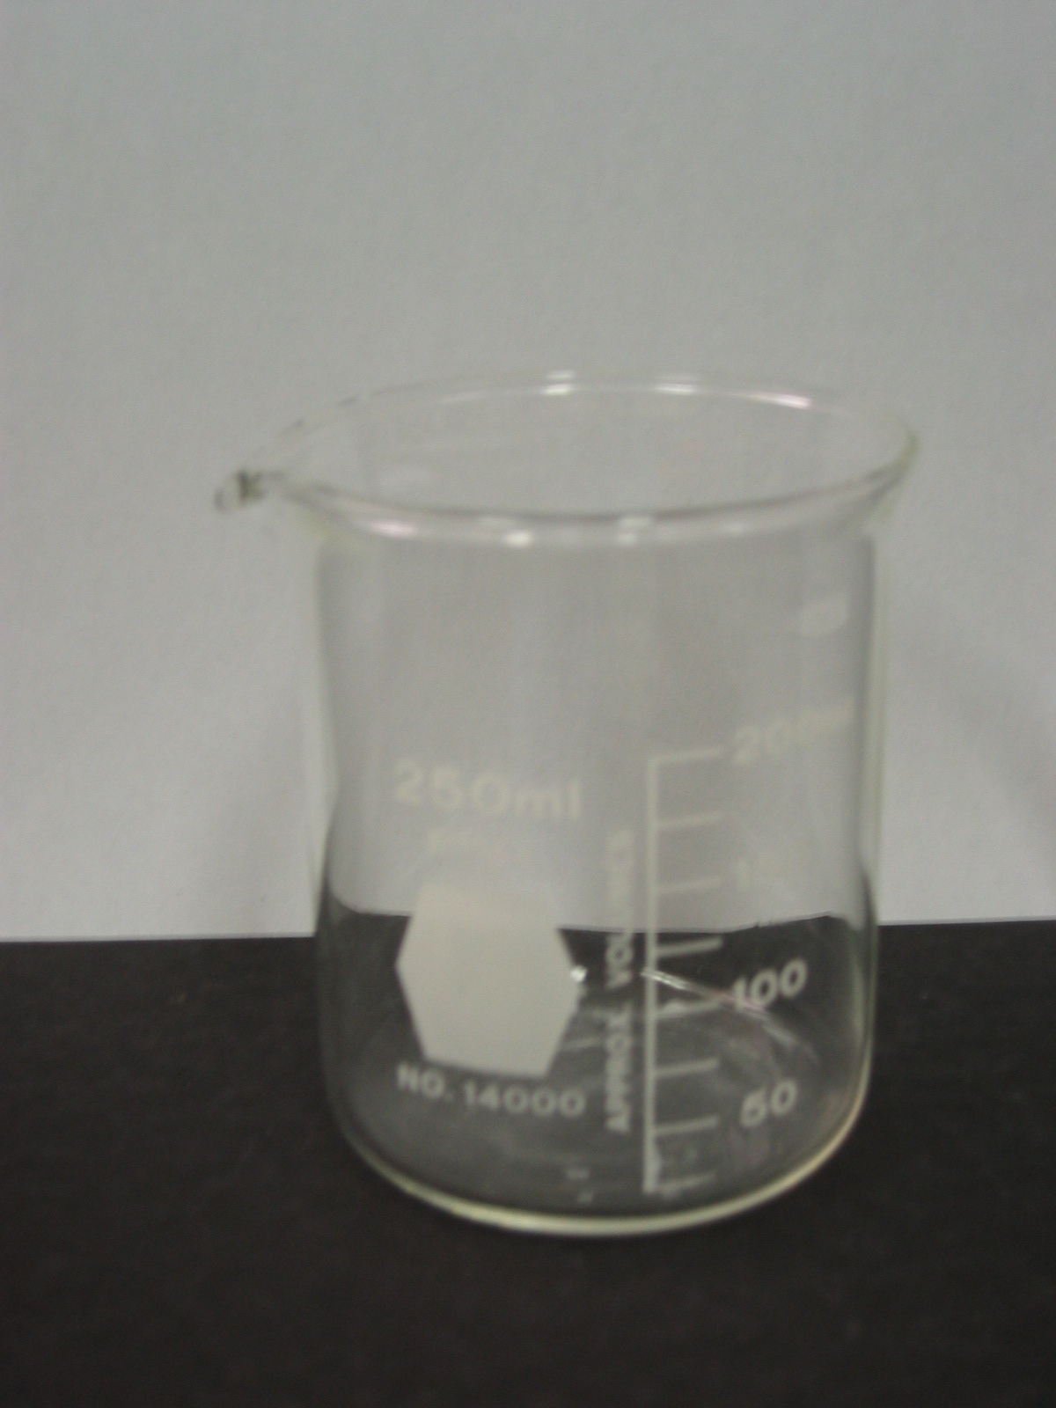
Basic Laboratory Equipment
BEAKER
Used for holding chemicals and testing chemical reactions.

Slide 3
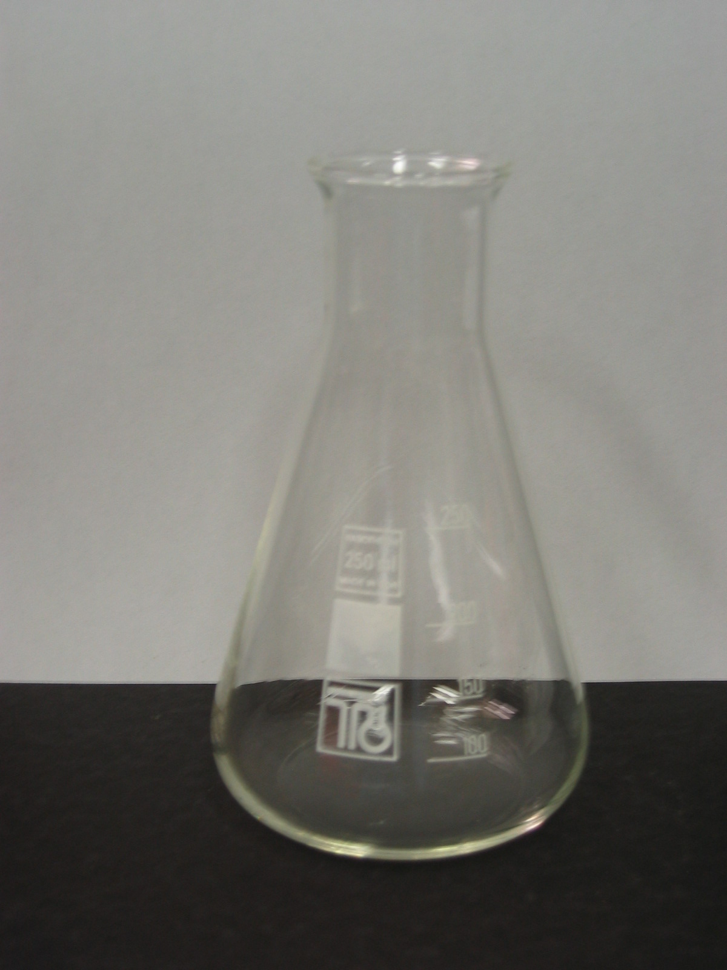
Basic Laboratory Equipment
CONICAL FLASK
Used for holding chemicals and testing chemical reactions.

Slide 4
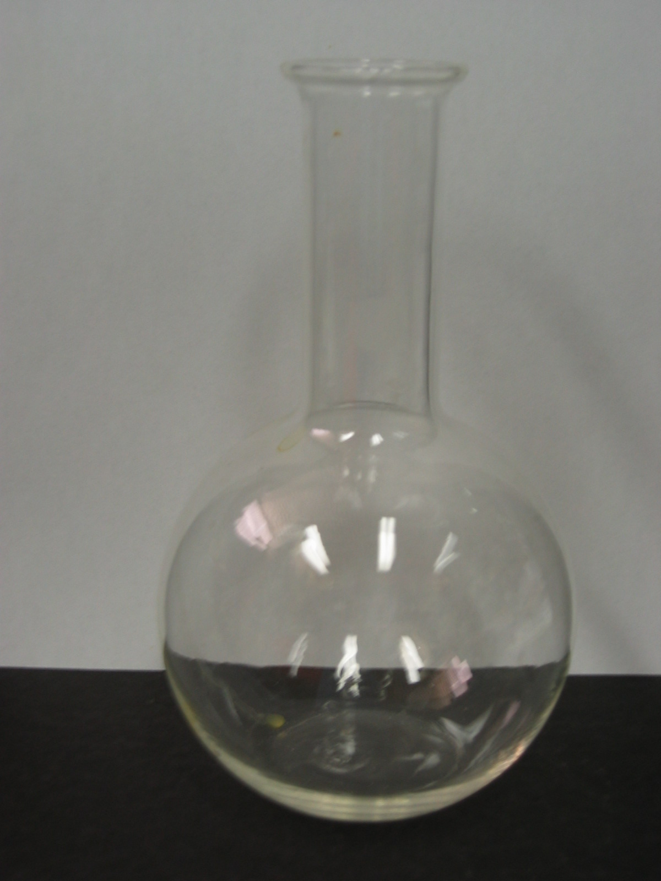
Basic Laboratory Equipment
FLAT BOTTOM FLASK
Used for holding chemicals and testing chemical reactions.

Slide 5
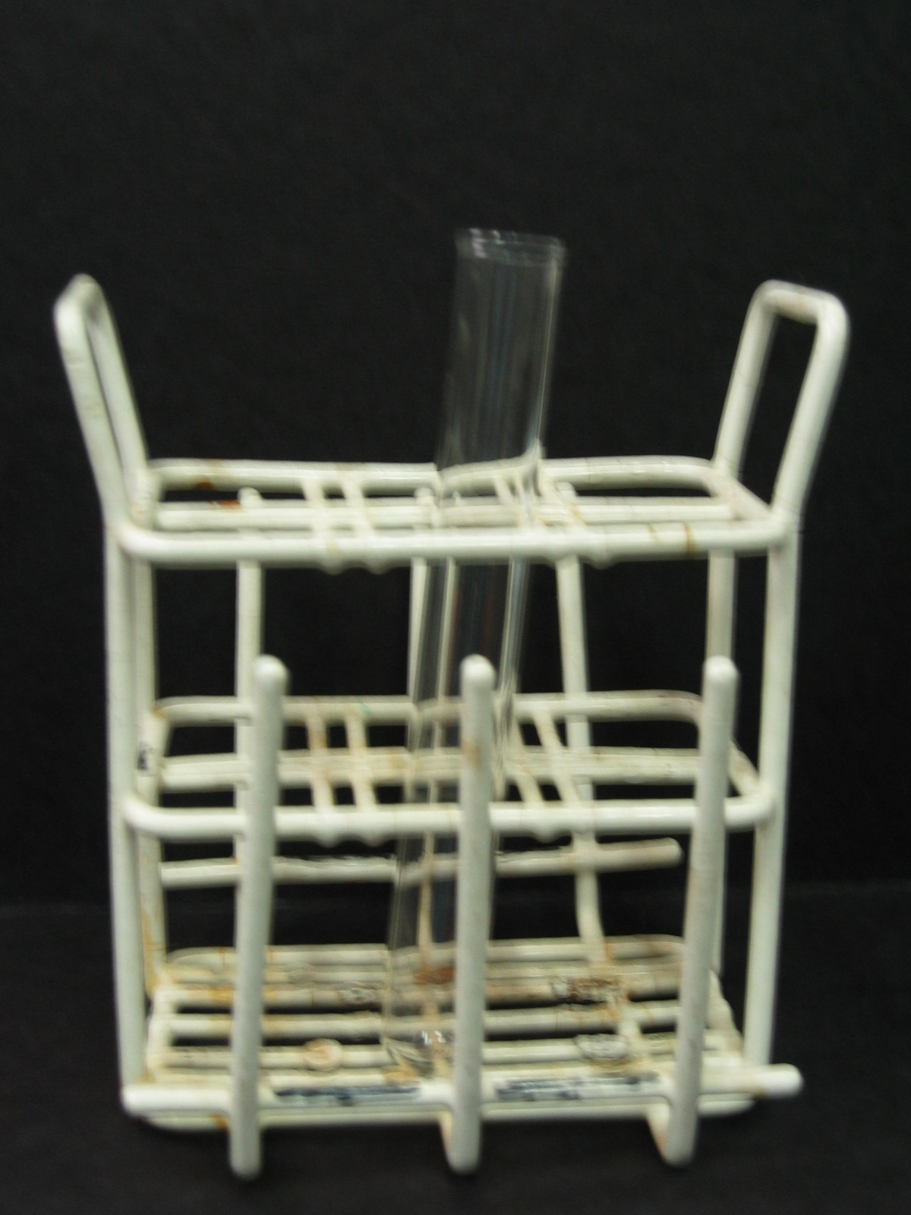
Basic Laboratory Equipment
TEST TUBE
Used for holding chemicals and testing chemical reactions.
TEST TUBE RACK
Used for holding test tubes.

Slide 6
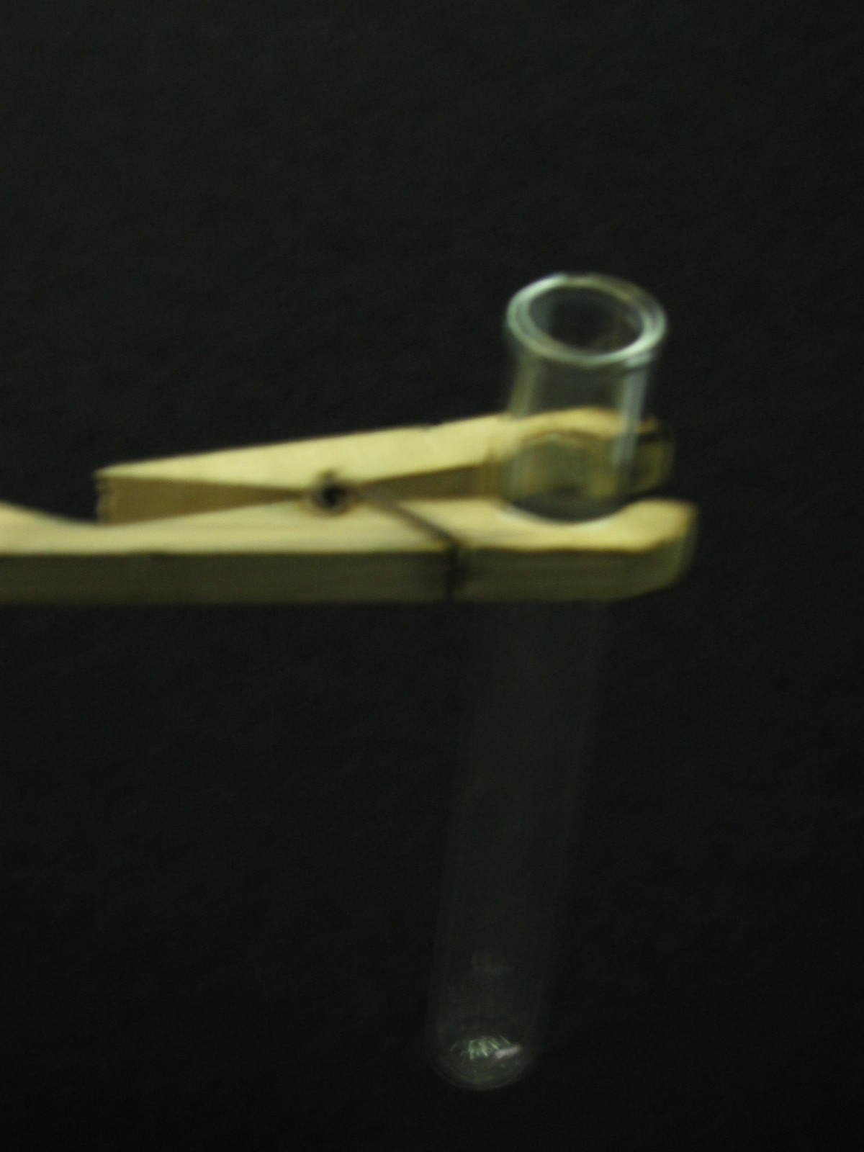
Basic Laboratory Equipment
TEST TUBE HOLDER
Used for holding test tubes over a Bunsen Burner.

Slide 7
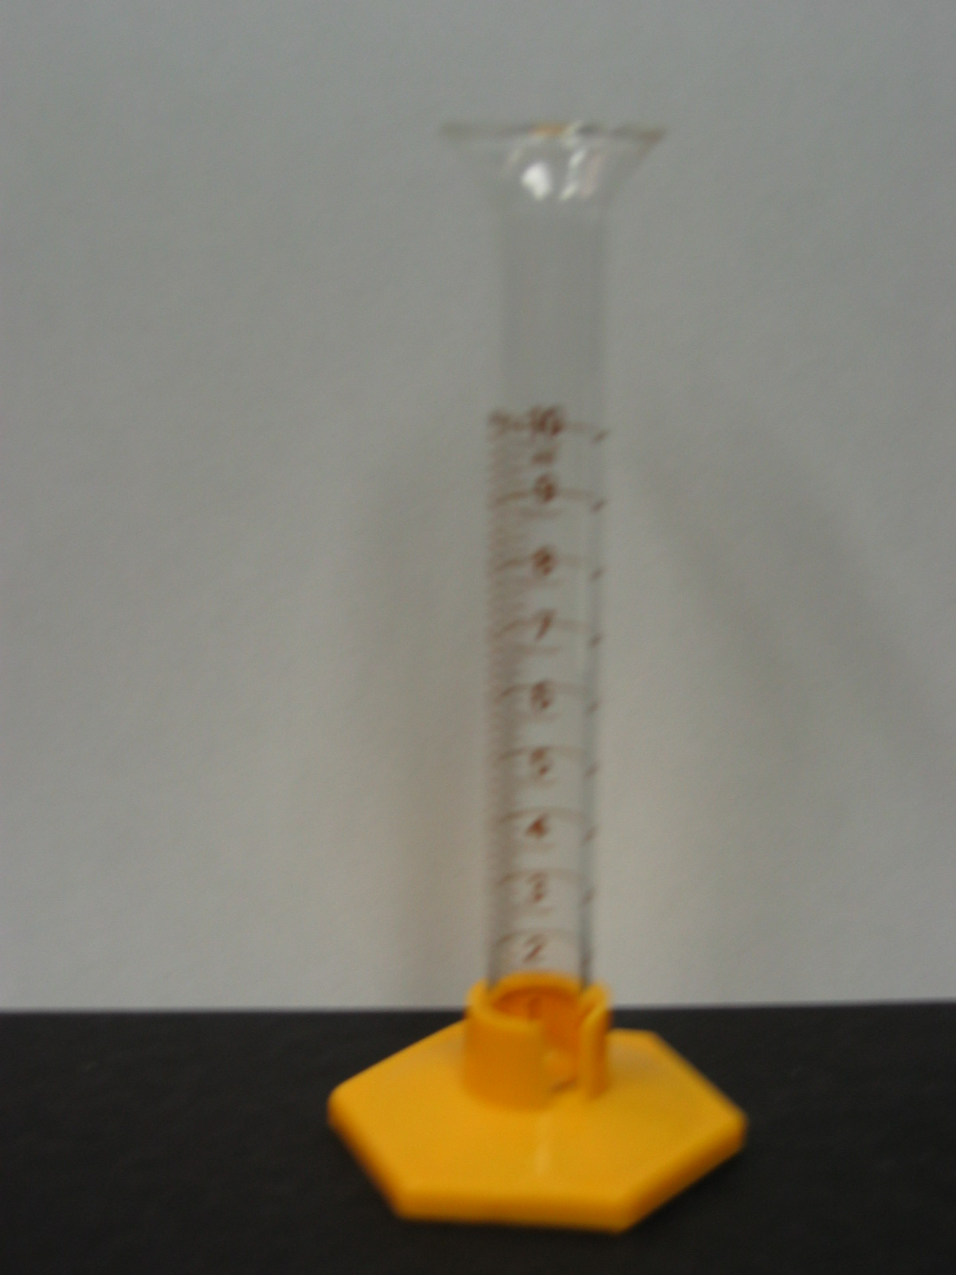
Basic Laboratory Equipment
MEASURING CYLINDER
Used for measuring precise volumes of liquids.

Slide 8
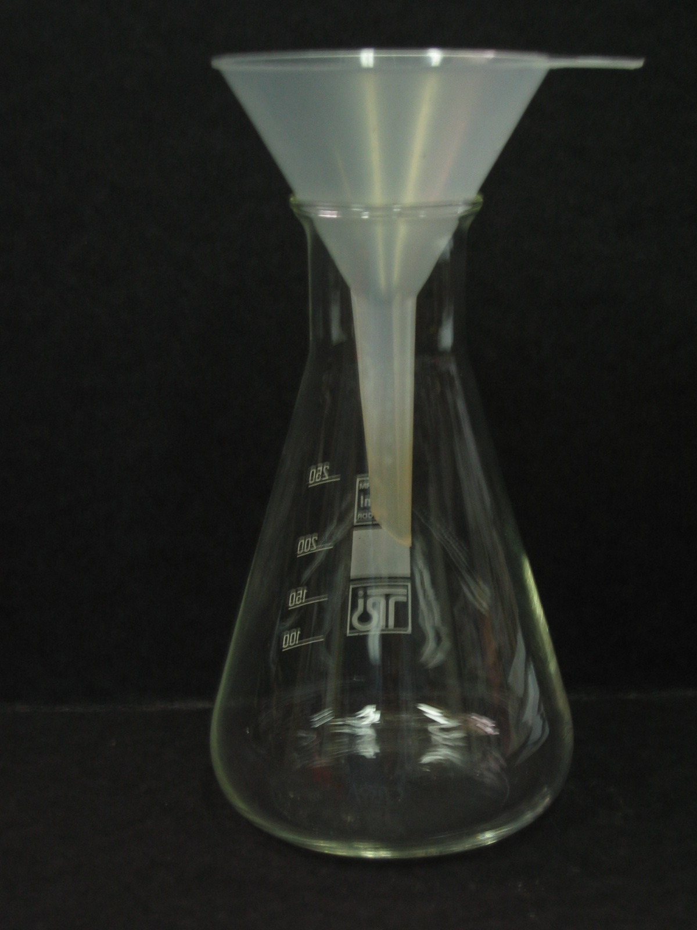
Basic Laboratory Equipment
FILTER FUNNEL
Used for filtering and pouring liquids into other containers.

Slide 9
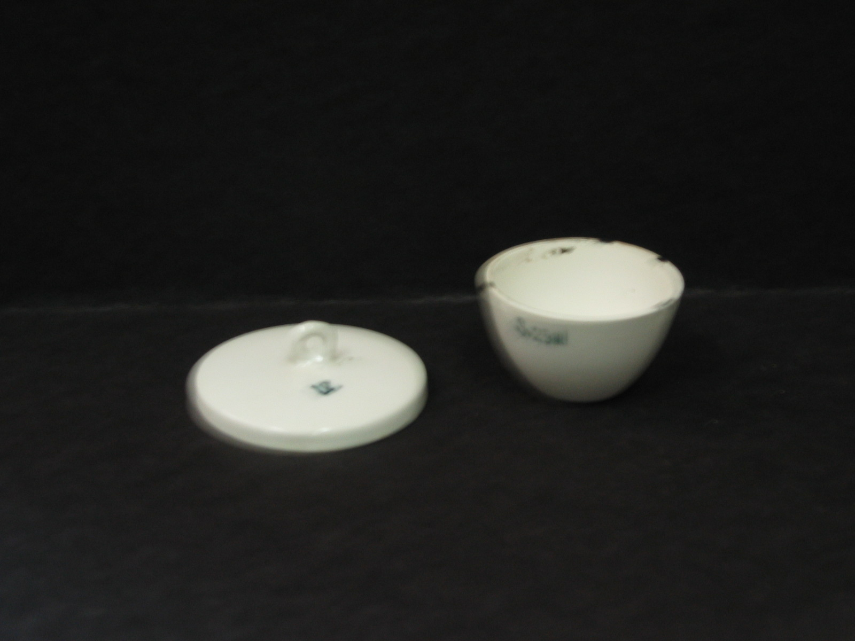
Basic Laboratory Equipment
CRUCIBLE AND LID
Used for heating chemicals to very high temperatures.

Slide 10
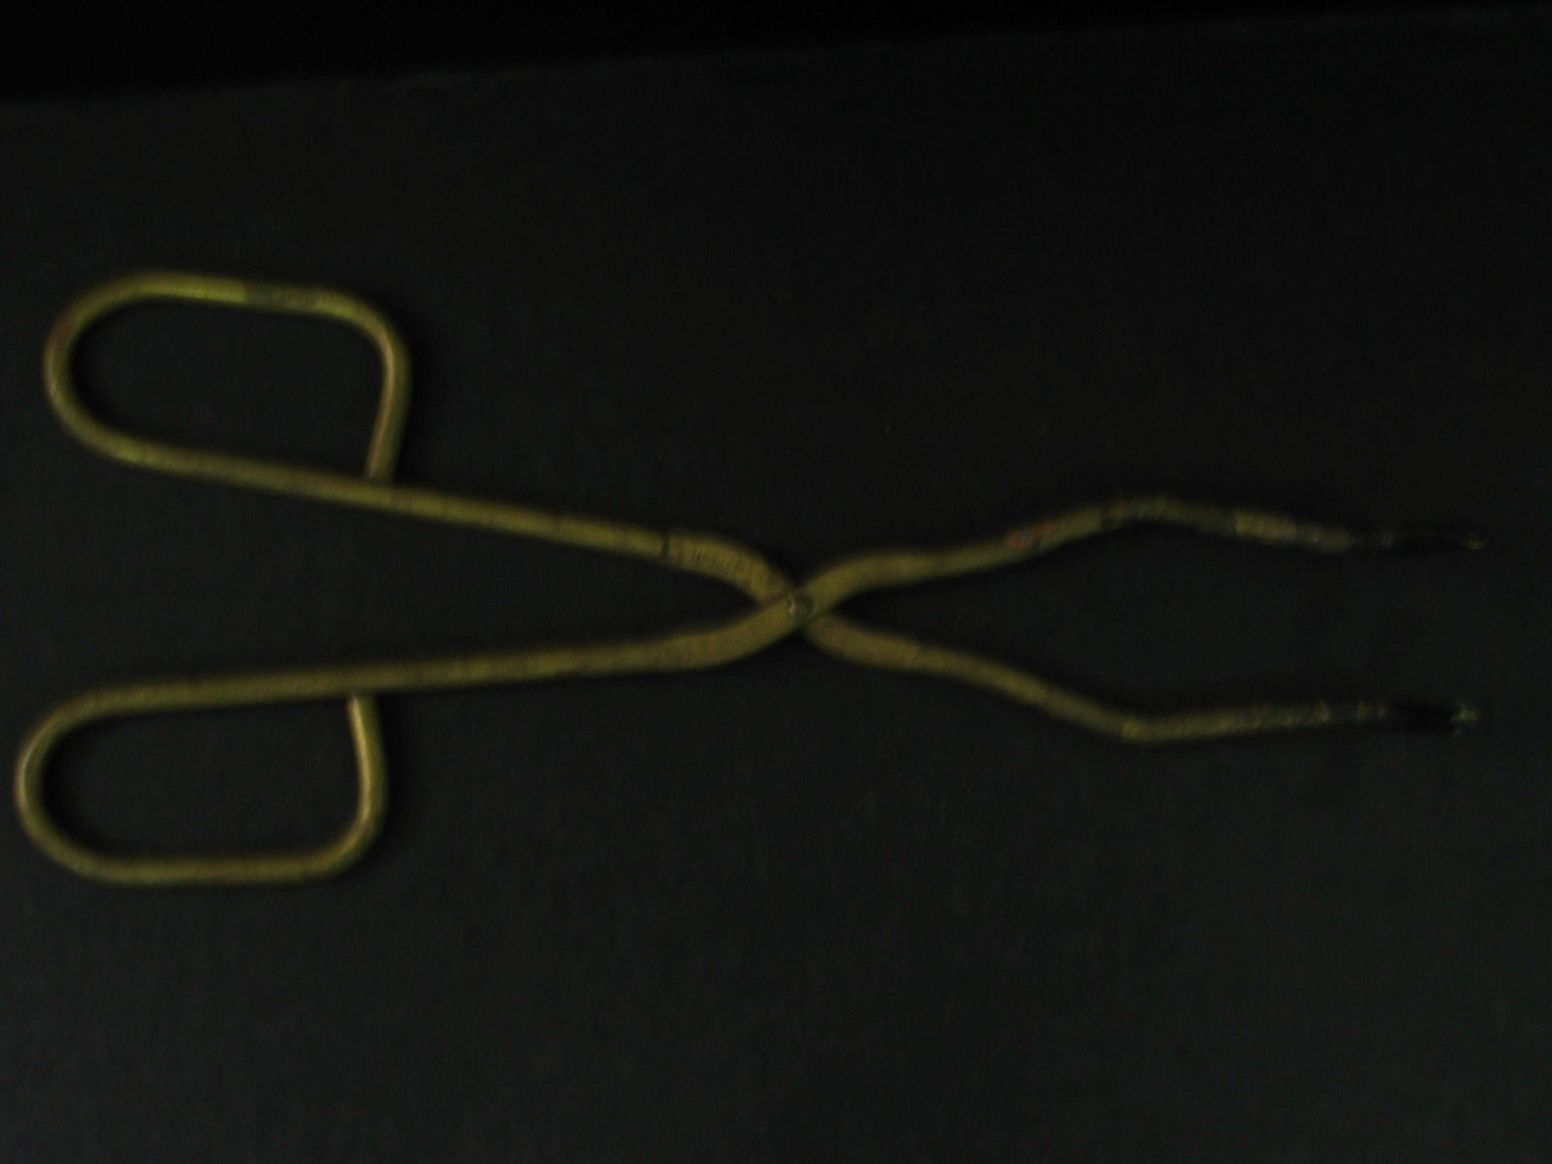
Basic Laboratory Equipment
CRUCIBLE TONGS
Used for holding a crucible and other hot objects.

Slide 11
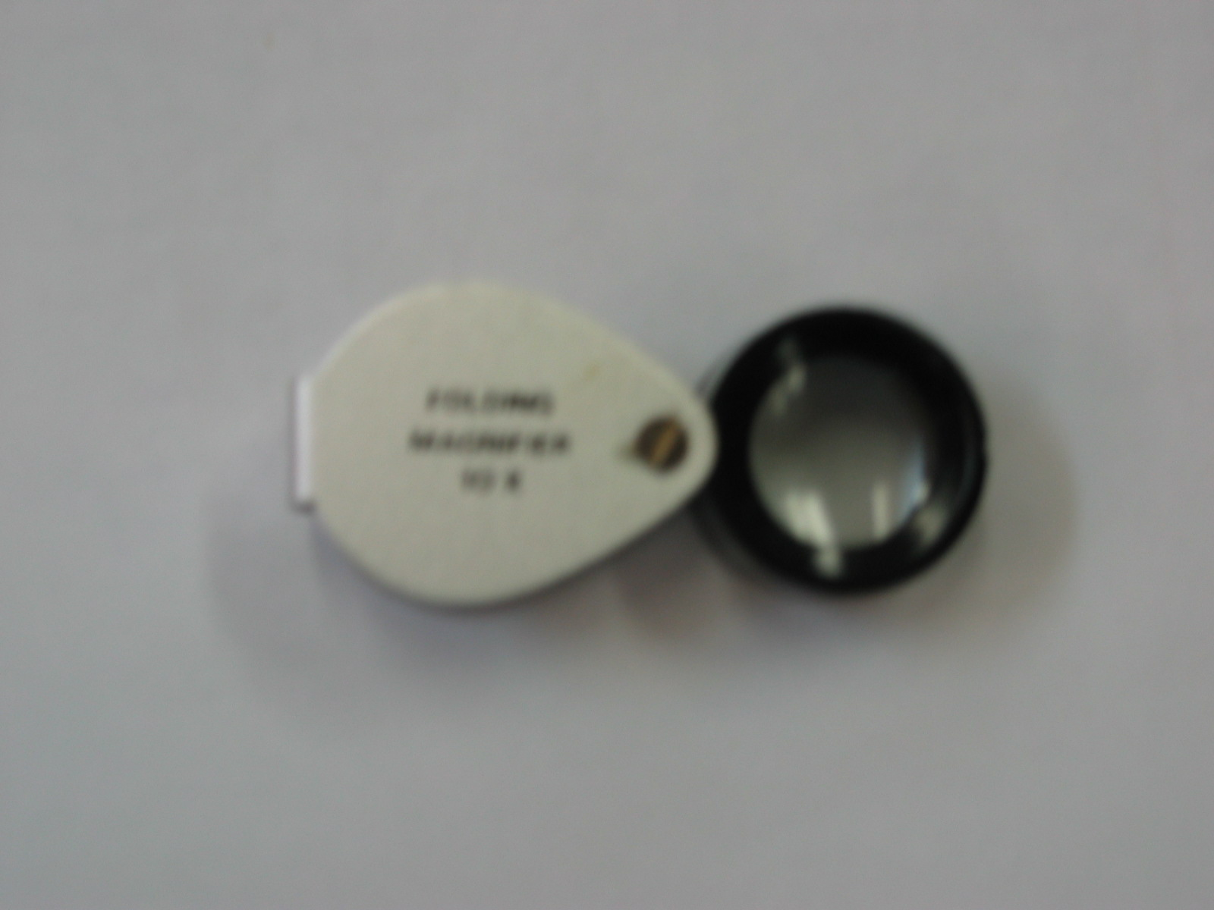
Basic Laboratory Equipment
HAND LENS
Used to magnify or make objects appear larger.

Slide 12
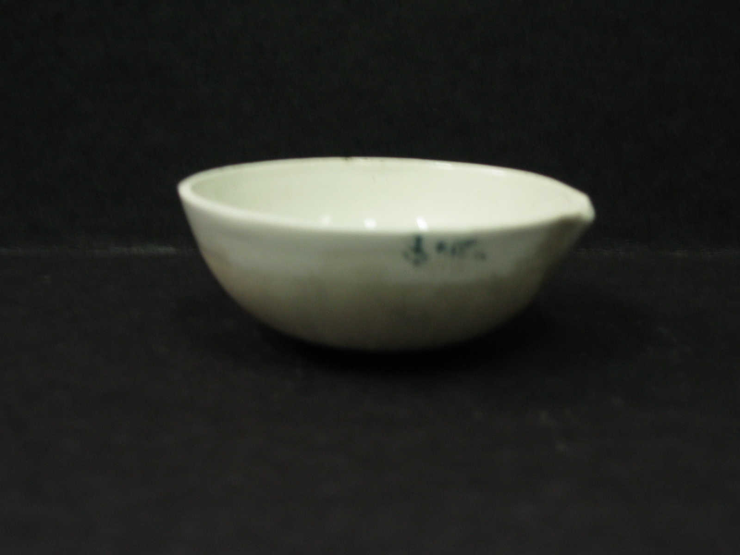
Basic Laboratory Equipment
EVAPORATING BASIN
Used for heating liquids to a high temperature.

Slide 13
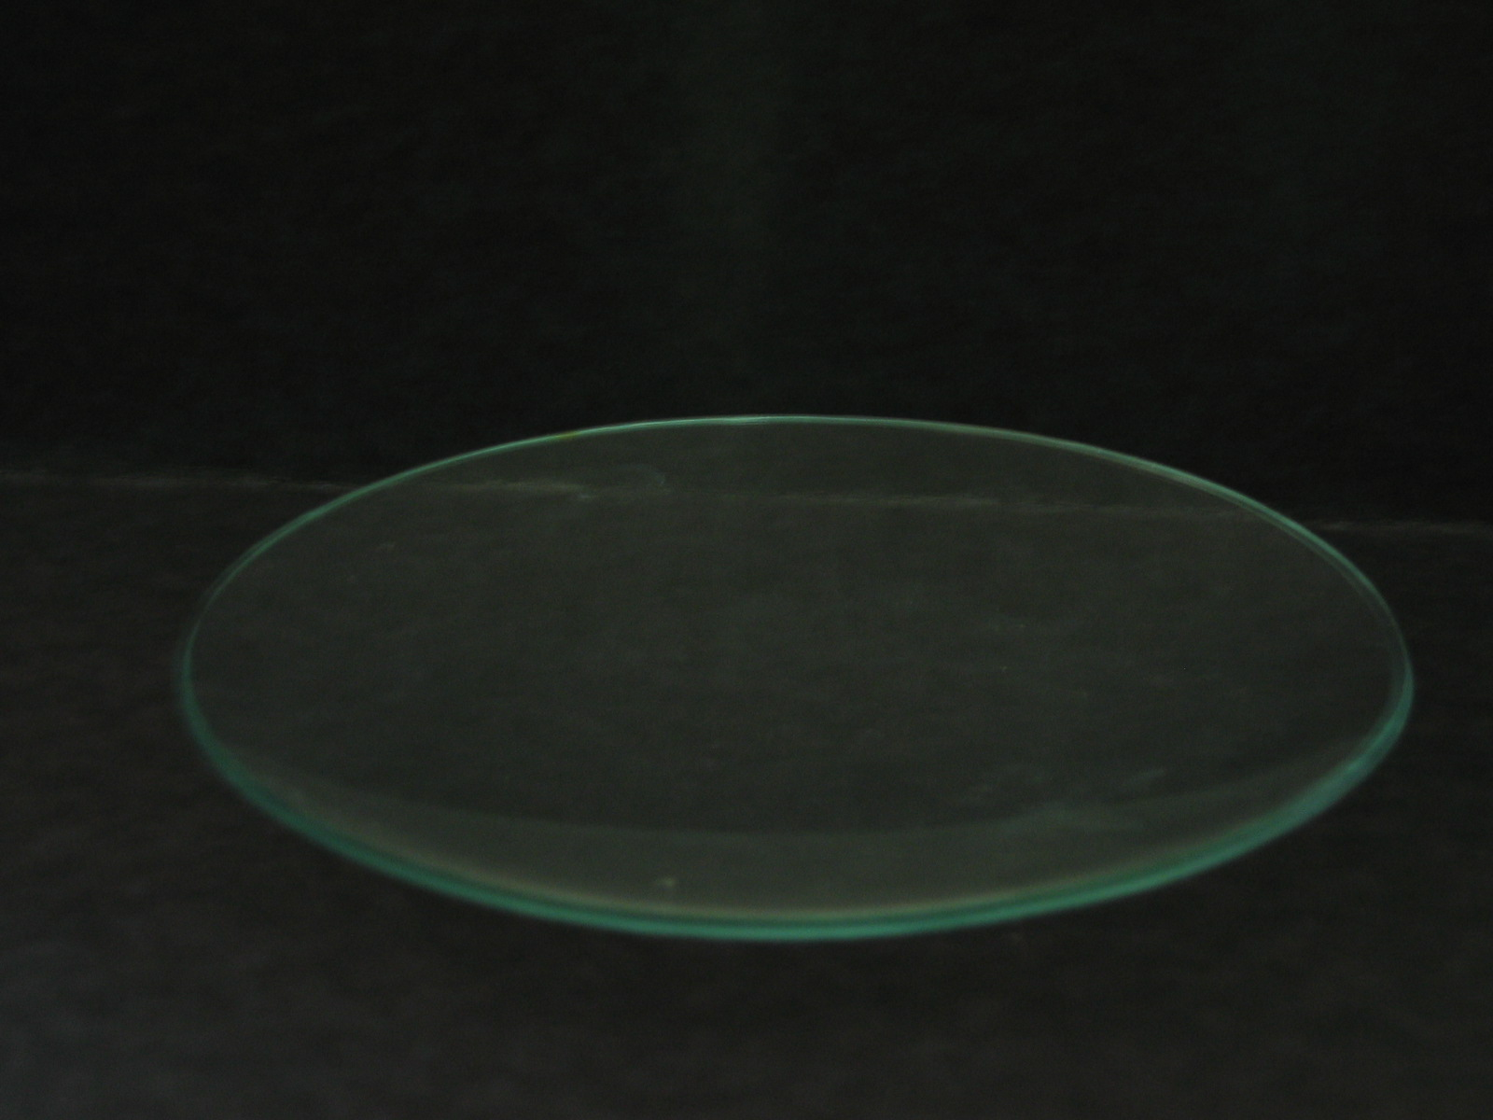
Basic Laboratory Equipment
WATCH GLASS
Used for holding chemicals and testing chemical reactions.

Slide 14
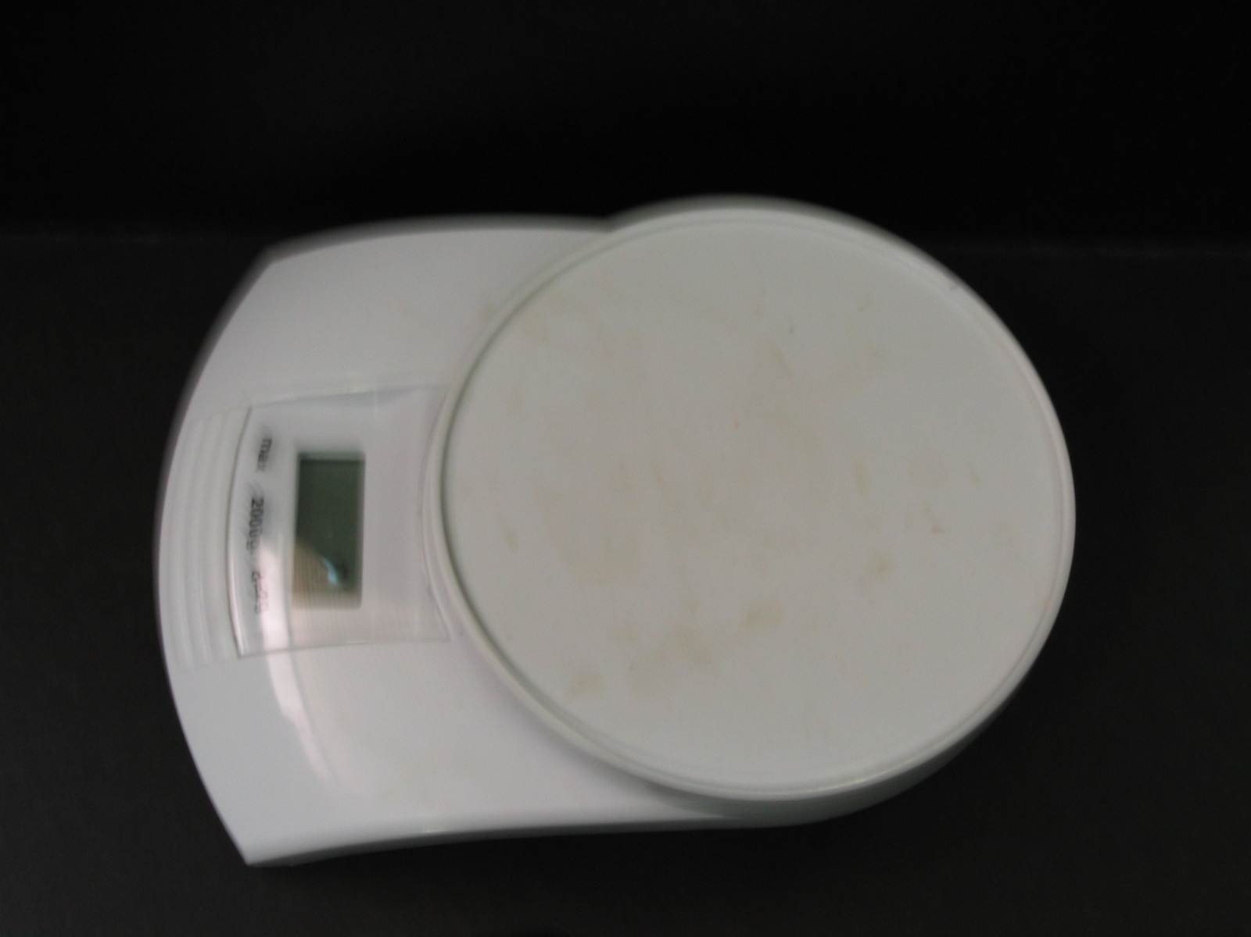
Basic Laboratory Equipment
ELECTRONIC BALANCE
Used for measuring how much something weighs.

Slide 15
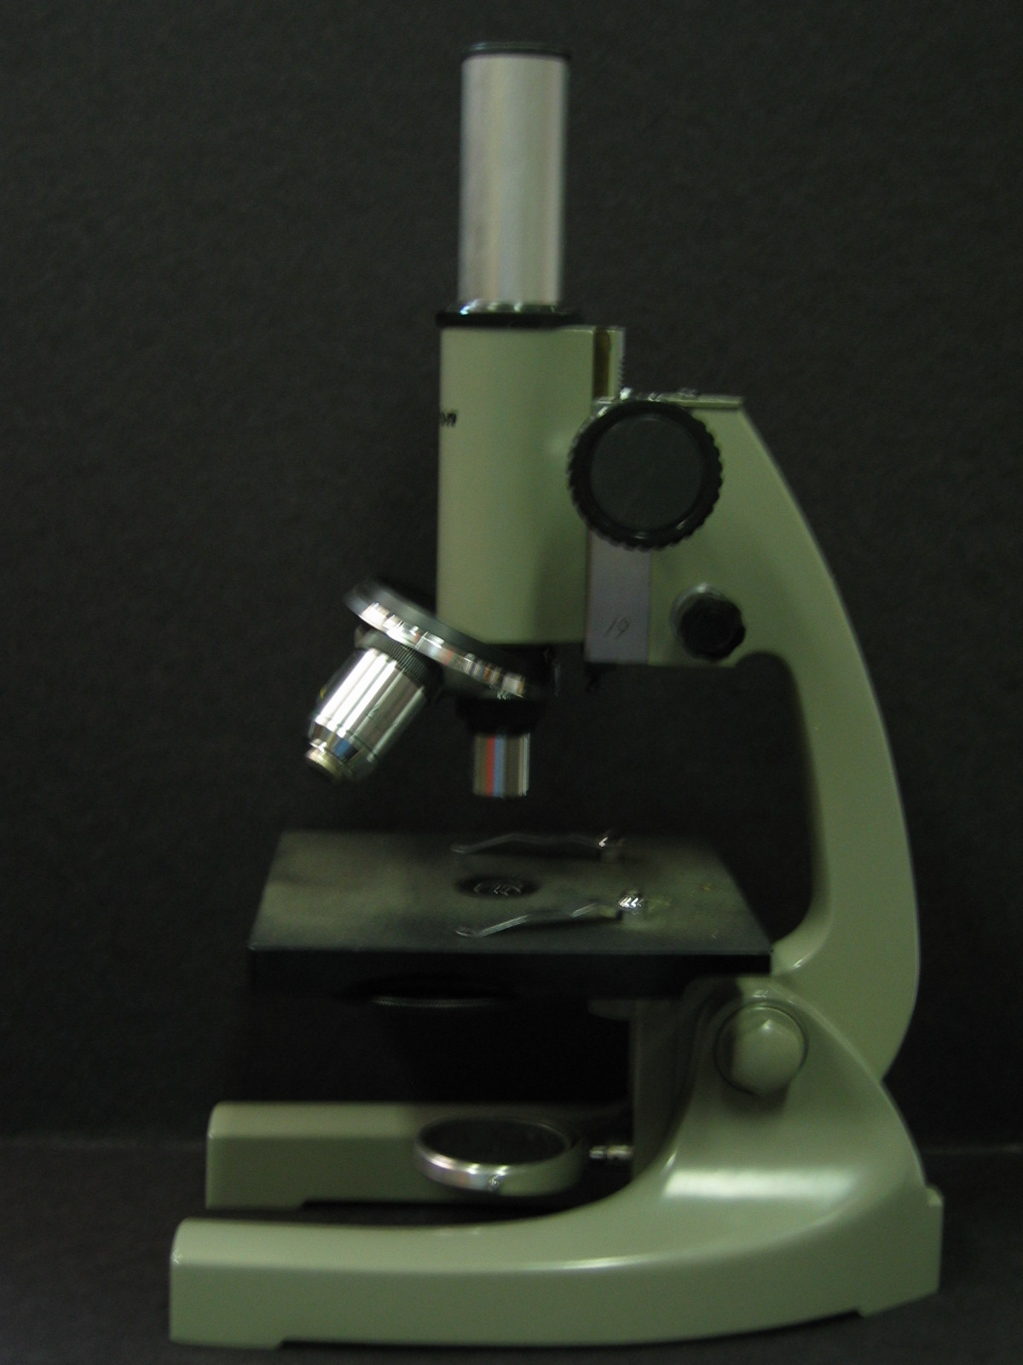
Basic Laboratory Equipment
MICROSCOPE
Used for making very small objects appear larger so that you can see them.

Slide 16
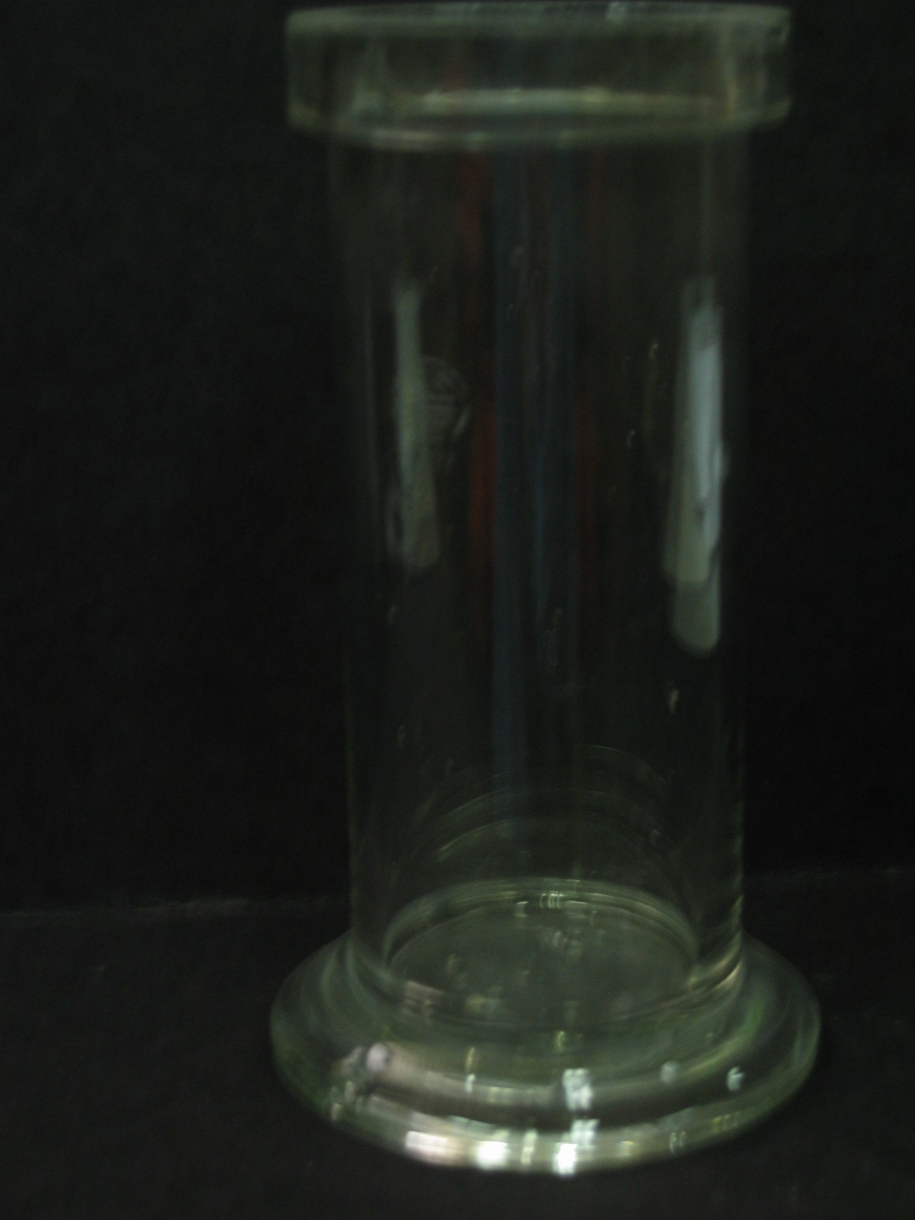
Basic Laboratory Equipment
GAS JAR
Used for holding gases after they have been made.

Slide 17
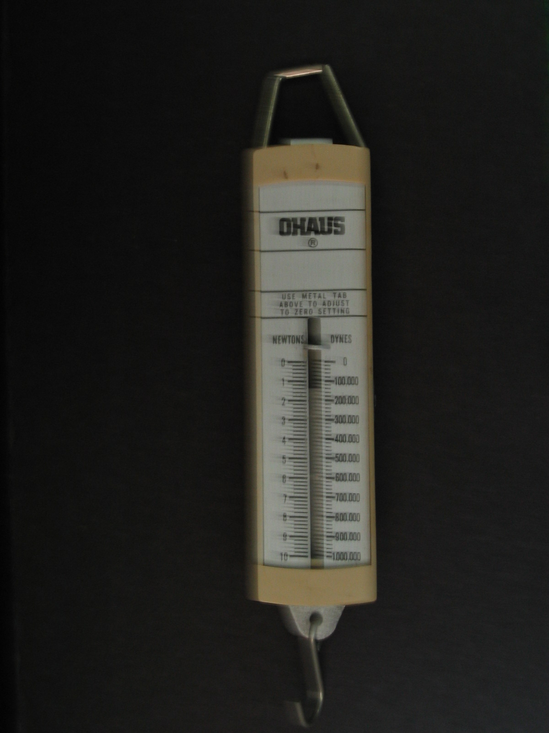
Basic Laboratory Equipment
SPRING BALANCE
Used for measuring force or weight.

Slide 18
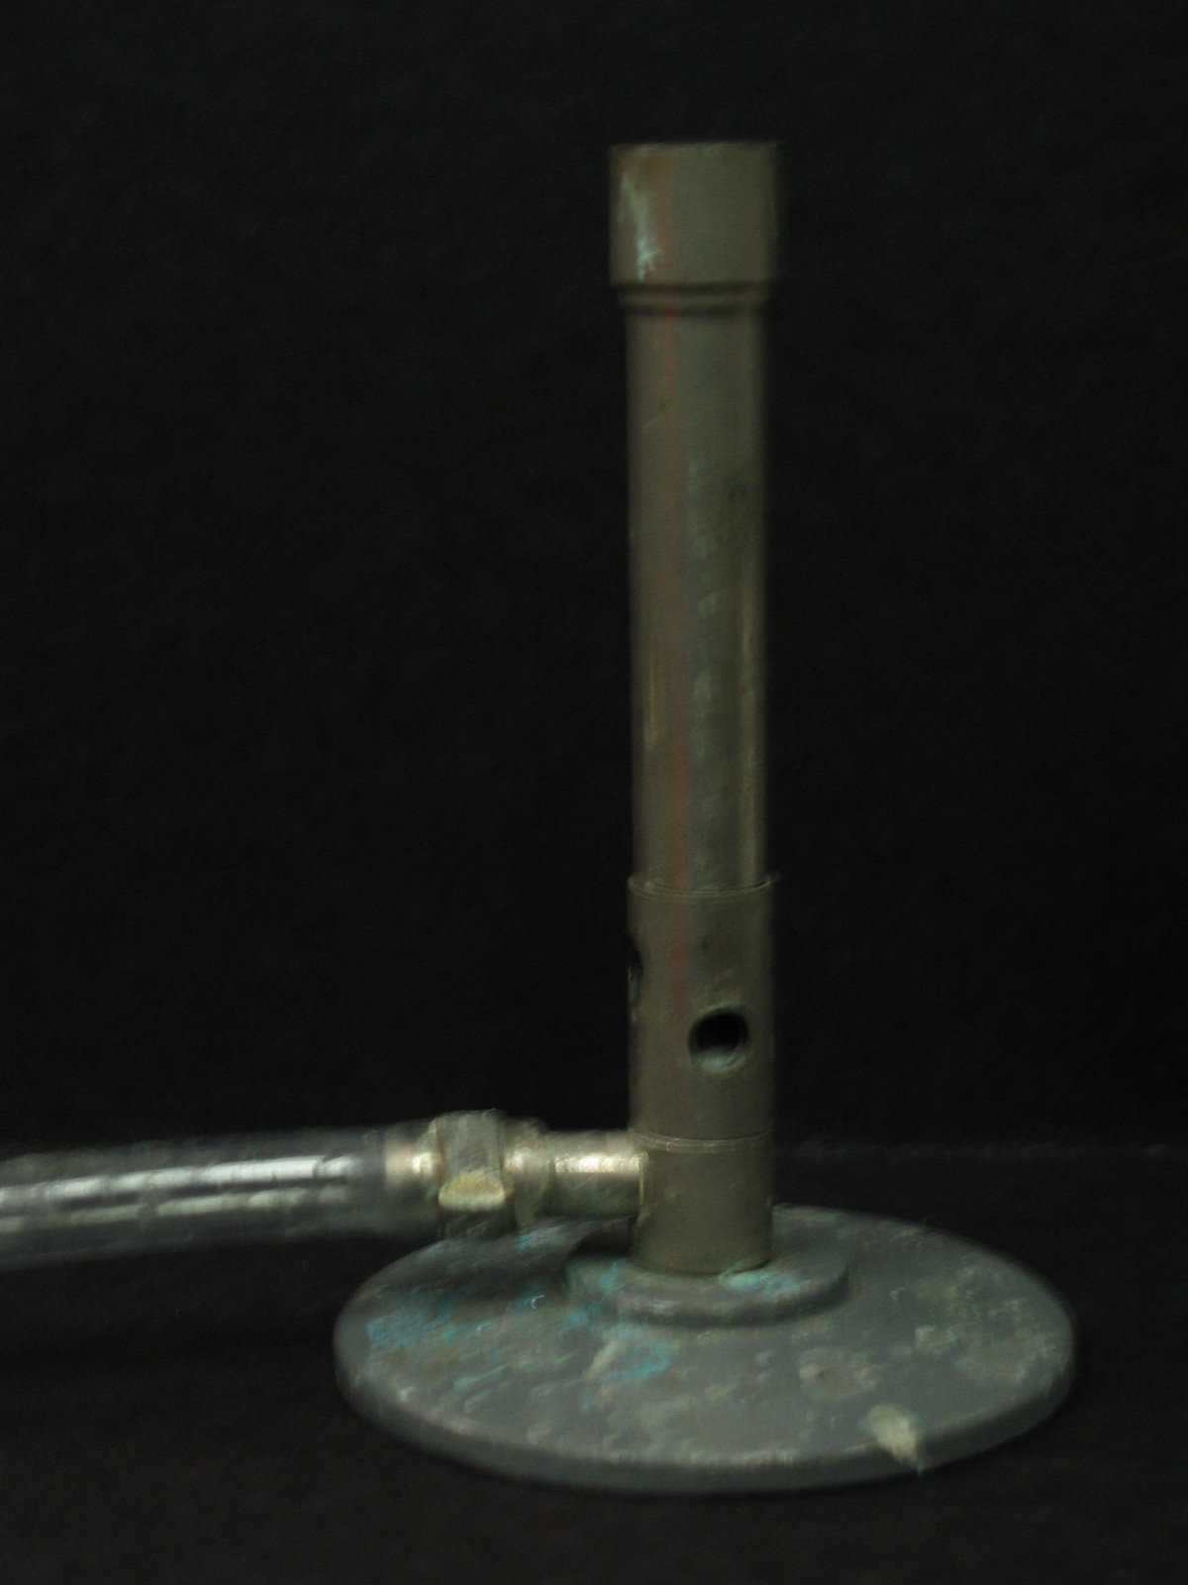
Basic Laboratory Equipment
BUNSEN BURNER
Used for heating chemicals and equipment.

Slide 19
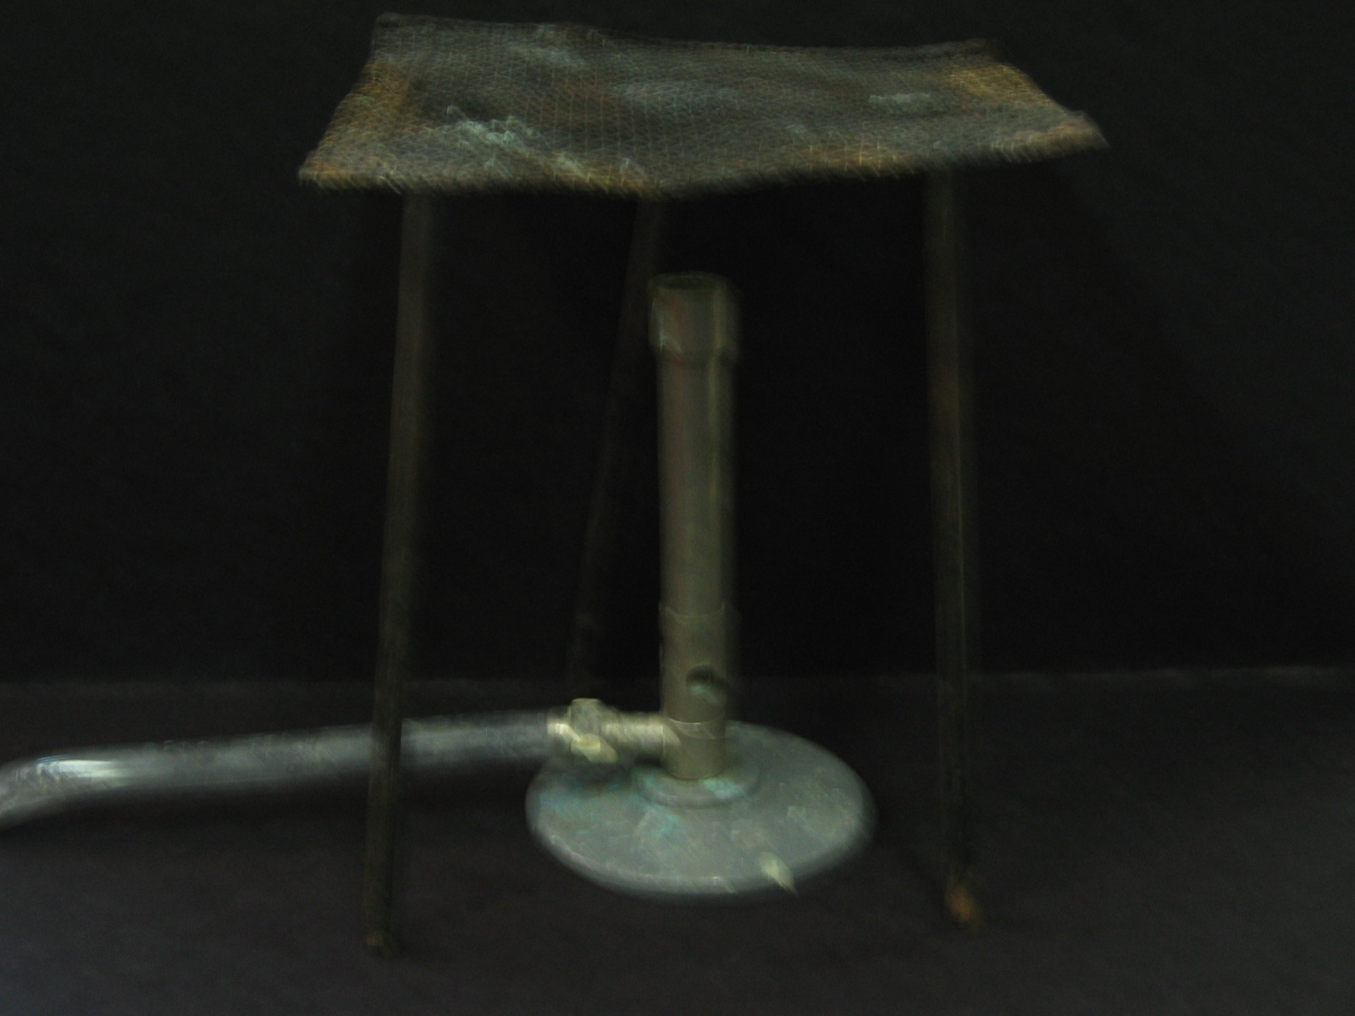
Basic Laboratory Equipment
BUNSEN BURNER with TRIPOD and GAUZE MAT
Used for holding equipment when it is being heated. The gauze mat spreads the heat evenly.

Slide 20
Basic Laboratory Equipment
Name the following items:

Slide 21
Basic Laboratory Equipment

